Slide 1
GROUP 6

Slide 2
Human Resources Department
Attendance
Sick Leave
Vacation Leave
Offset
Maternity Leave
Activity Calendar
Sharing of documents (scanned/pictures)

Slide 3
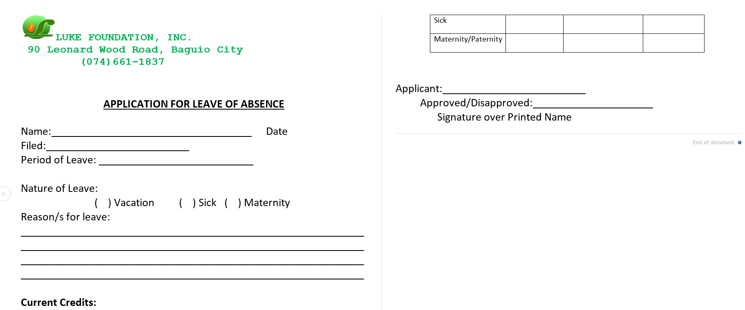
BASIS:

Slide 4
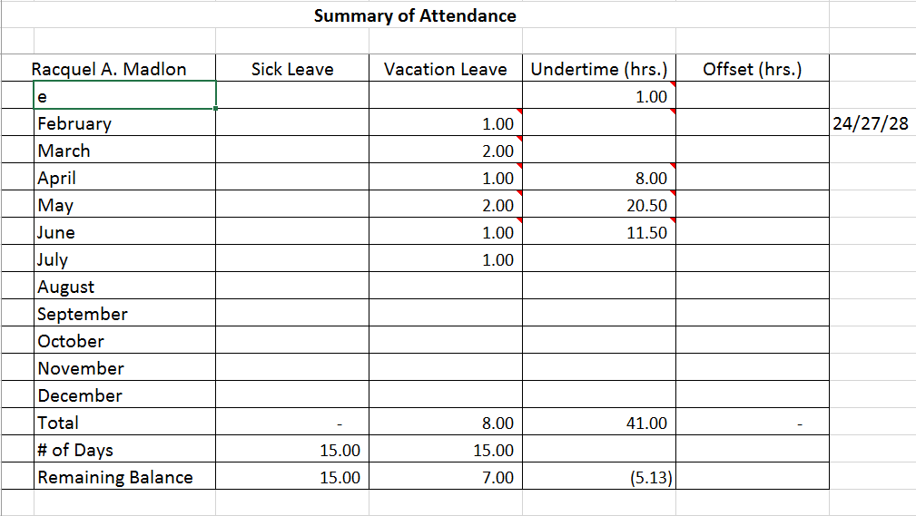
BASIS:

Slide 5
Tables used:
Attendance_Counter
Attendance_Record
Personnel
Activity_list
Organizer

Slide 6
Attendance Counter
ENTITIES:
DATA TYPE:
ID -> (PRIMARY KEY)
Staff_ID -> (FOREIGN KEY)
Year
Sick_leave_balance
Vac_leave_balance
Vac_leave_ctr
Maternity_leave
Sick_leave_ctr
Integer (Auto-increment)
Tiny int
Year
Integer
Integer
Integer
Boolean
integer

Slide 7
Attendance Record
ENTITIES:
DATA TYPE:
ID -> (PRIMARY KEY)
Staff_ID -> (FOREIGN KEY)
Year
Remark
Start
End
Integer (Auto-increment)
Tiny int
Year
Varchar
Date
Date

Slide 8
Personnel
ENTITIES:
DATA TYPE:
Tiny int(1)
Varchar
Varchar
Varchar
date
Varchar
integer
Varchar
Varchar
Staff_ID -> (PRIMARY KEY)
Lastname
Firstname
Middlename
Birthdate
Address
Contact Number
Email Address
Staff Type

Slide 9
Activity List
ENTITIES:
DATA TYPE:
ID -> (PRIMARY KEY)
Activity
Date
Location
Organizer_ID -> (FOREIGN KEY)
Staff_ID -> (FOREIGN KEY)
Integer
Varchar
Date and time
Varchar
Varchar
Varchar

Slide 10
Organizer
ENTITIES:
DATA TYPE:
Org_ID -> (PRIMARY KEY)
Org_name
Rep_name
Rep_contact
Rep_email
Rep_address
Tiny Int
Varchar
Varchar
Integer
Varchar
Varchar

Slide 11
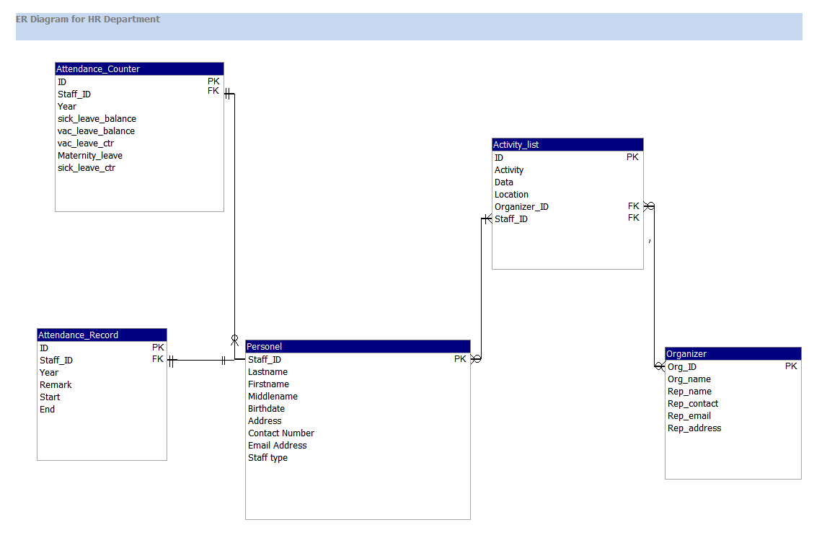
ER DIAGRAM
files
manage
organizes
Registers

